Slide 1
SOF 103
C and C++ Programming
Chapter 6
Files

Slide 2
Files
The programs you have written so far keeps the data temporarily in RAM, and user need to re-enter the data each time the program runs.
When a program needs to save data for later use, it writes the data in a file. The data can be read from the file at a later time.
Some software which store data files:
  Word processors, Image editors, Spreadsheets, Games and Web browsers

Slide 3
File Handling Steps
Include a required header file
Define a file stream object
Open the file
Use the file
  read from, write to, or both
Close the file

Slide 4
Types of Files
Text
  A text file contains data that has been encoded as text, using a scheme such as ASCII or Unicode. Even if the file contains numbers, those numbers are stored in the file as a series of characters.
  Such a file can be viewed in a text editor.
Binary
  A binary file contains data that has not been converted
  to text. As a consequence, you cannot view the contents of a binary file with a text editor.
  The contents of binary file are not readable in the text editor.

Slide 5
File Access Methods
Sequential
  In sequential access, the data is accessed from the beginning of the file to the end of the file.
Random Access File
  In random access, you can directly access any piece of data in the file without reading the data that comes before it.

Slide 6

File Names and File Stream Objects
Files on the disk are identified by their names:
In order for a program to work with a file on the computer’s disk, the program must create a file stream object in memory.
A file stream object is an object that is associated with a specific file and provides a way for the program to work with that file.

Slide 7
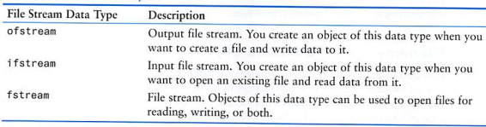
File Stream Objects
ofstream
ifstream
fstream

Slide 8
Creating a file object and opening a file
Before data can be read or written to a file, following steps must be done:
  A file stream object must be created.
  The file must be opened and linked to the file stream object.
Example of opening a file for input (reading)
  ifstream inputFile;
  inputFile.open(“filename.txt”);
Example of opening a file for output (writing)
  ofstream outputFile;
  outputFile.open(“filename.txt”); OR
  outputFile.open(“C:\\SOF103\\filename.txt”);

Slide 9
Closing a File
Although a program’s files are automatically
closed when the program shuts down, it is a good programming practice to write statements
that explicitly close them.
Calling the file stream object’s close member function closes the file associated with it.
  inputFile.close();

Slide 10
Writing Data to a File
You already know how to use the stream insertion operator (<<) with the cout object to write data to the screen.
It can also be used with ofstream objects to write data to a file.
Assuming outputFile is an ofstream object, the following statement demonstrates using the << operator to write a string literal to a file:
outputFile << "This will be written in a file\n";
outputFile << “Message " << variable << endl;

Slide 11
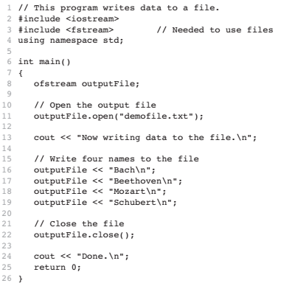

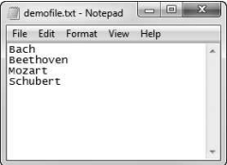
A Program to Write Data to a File

Slide 12
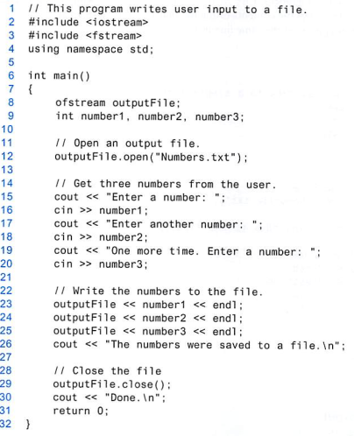
Writing user input
to a file.

Slide 13
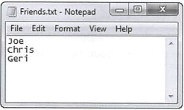
Reading Data From a File
The >> operator not only reads data from the cin object, but also data from a file.
Assuming inputFile is an ifstream object:
inputFile >> name;

Slide 14
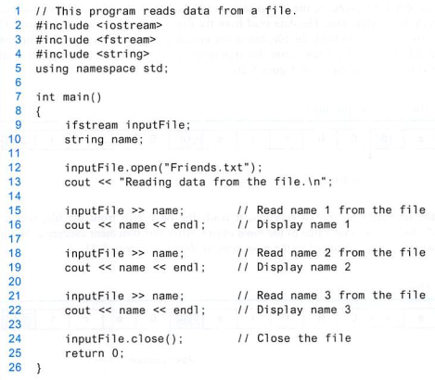

Slide 15



The Read Position

Slide 16
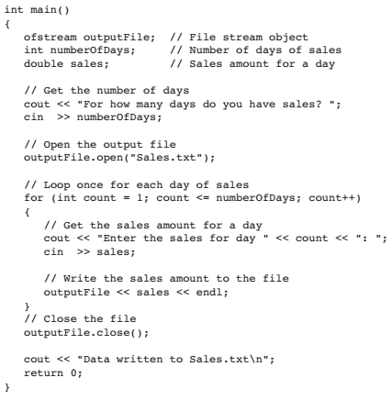
Using loops
to process files

Slide 17
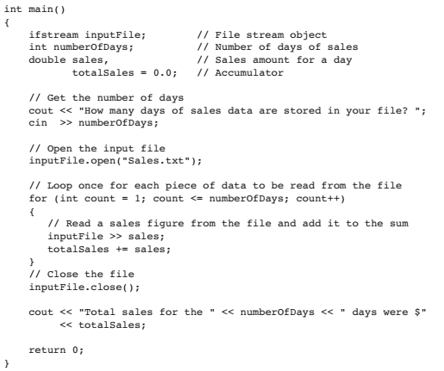
Reading!

Slide 18
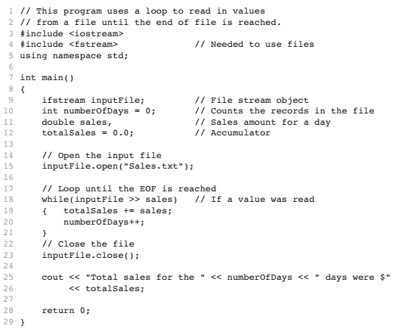
Detecting the End of the File

Slide 19
Testing for File Open Errors
Under certain circumstances, the open member function will not work. For example, the
following code will fail if the file info.txt does not exist or cannot be found in the expected directory:
fstream inputFile;
inputFile.open("info.txt");
Fortunately, there is a way to determine whether the open member function successfully opened the file.

Slide 20
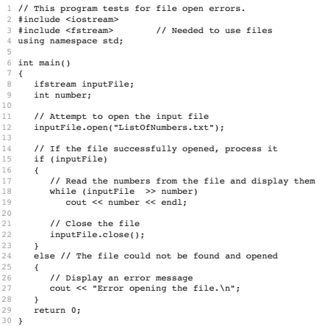

Slide 21
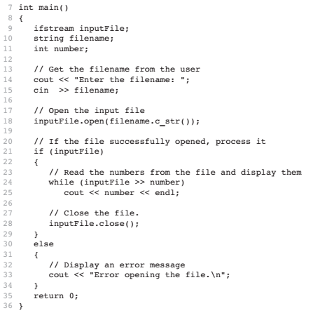
Getting the File Name as Input from the User

Slide 22
File streams
  Input and output activities are managed in streams. Data may flow from cin or into cout.
  Previously we used istream & ostream (iostream).
  Now, To replace the console and keyboard with file, we use ifstream & ofstream objects. Both ifstream & ofstream are defined in <fstream>.
Compiled by Dr. Hew

Slide 23
Output file streams
  To open and close an output file stream:
  ofstream fileObject;
  fileObject.open(filename);
  .
  .
  fileObject.close();
  Example:
  ofstream file1;
  file1.open(“customer.txt”);
  .
  .
  file1.close();
Compiled by Dr. Hew

Slide 24
Options for output file streams
  To open and close an output file stream:
  ofstream fileObject;
  fileObject.open(filename, option);
  .
  .
  fileObject.close();
  ios::out(default) → Remove existing data, and start at location o.
  ios::app→ Start at the end. Cannot modify existing data.
Compiled by Dr. Hew

Slide 25
Input file streams
  To open and close an input file stream:
  ifstream fileObject;
  fileObject.open(filename);
  .
  .
  fileObject.close();
  Example:
  ifstream file1;
  file1.open(“customer.txt”);
  .
  .
  file1.close();
Compiled by Dr. Hew

Slide 26
Input file streams (cont…)
  There is only one mode for ifstream→ iso::in
  We use if(!inFile) to check whether a file is opened?
  - inFile will return false if the file does not exist.
  get() getline()
  while(!inFile.eof())
  {
  char c=inFile.get();
  cout<<c;
  }
  while(!inFile.eof())
  {
  char name[20];
  inFile.getline(name,20);
  cout<<name<<endl;
  }
Compiled by Dr. Hew

Slide 27
get()
  #include<iostream>
  #include<fstream>
  using namespace std;
  int main()
  {
  fstream file1;
  file1.open("customer.txt",ios::in); // append
  while(!file1.eof())
  {
  char c=file1.get();
  cout<<c;
  }
  file1.close();
  return 0;
  }
Compiled by Dr. Hew

Slide 28
getline()
  #include<iostream>
  #include<fstream>
  using namespace std;
  int main()
  {
  fstream file1;
  file1.open("customer.txt",ios::in); // append
  while(!file1.eof())
  {
  char name[20];
  file1.getline(name,20);
  cout<<name<<endl;
  }
  file1.close();
  return 0;
  }
Compiled by Dr. Hew

Slide 29
End of file
  In C++, the special character “end of file” is represented by the variable eof.
  It is always at the end of a file.
Compiled by Dr. Hew

Slide 30
fstream
  To open and close an input file stream:
  fstream fileObject;
  fileObject.open(filename，option);
  .
  .
  fileObject.close();
  fstream file1;
  file1.open(“customer.txt”, ios::out); //write
  .
  .
  file1.close();
Compiled by Dr. Hew

Slide 31
Example (write)
  #include<iostream>
  #include<fstream> //step 1
  using namespace std;
  int main()
  {
  fstream file1; // step 2
  file1.open("customer.txt",ios::out); // step 3 (write)
  if(file1) // step 4
  {
  file1<<"Halim Zhang\n";
  file1<<"Minyu\n";
  file1<<"Shuyi\n";
  file1.close(); // step 5
  }
  return 0;
  }
Compiled by Dr. Hew

Slide 32
Example (append)
  #include<iostream>
  #include<fstream> using namespace std;
  int main()
  {
  fstream file1;
  file1.open("customer.txt",ios::app); // append
  if(file1) {
  file1<<“SiYue\n";
  file1<<“Jizing\n";
  file1<<“Keyla\n";
  file1.close();
  }
  return 0;
  }
Compiled by Dr. Hew

Slide 33
Example (read)
  #include<iostream>
  #include<fstream>
  #include<string>
  using namespace std;
  int main()
  {
  fstream file1;
  file1.open("customer.txt",ios::in); // read
  if(file1) //file1.is_open()
  {
  string str;
  while(getline(file1,str))
  {
  cout<<str<<endl;
  }
  file1.close();
  }
  return 0;
  }
Compiled by Dr. Hew

Slide 34
References
  Problem Solving with C++ (10th Edition), Walter Savitch, Addison Wesley, 2018
  Paul J. Dietel, C++ How to Program (10th Edition), Pearson, 2017.
  Turbo C programming for the PC, Robert Lafore
  Dr. Kamran’s notes.
  CodeBeauty
Compiled by Dr. Hew

